Slide 1


NFL Player Manager
View Current Roster
View Current Draft
Initial NFL Player Manager screen allows CEO to view his current roster or the current draft

Slide 2
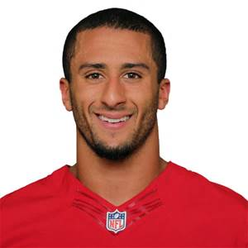
Current Roster
Colin Kaepernick - QB
Player 1 - RB
Player 2 - TE
Player 3 - WR
Player 4 - C
Player 5 – RG
Current roster shows a list box with all current players. Click player name to drop player from current roster.
Drop Player from Current Roster
Close

Slide 3
NFL Player Manager
View Current Roster
View Current Draft
Initial NFL Player Manager screen returns after current roster or current draft window is closed.

Slide 4
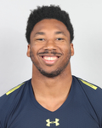
Current Draft
Myles Garrett
Mitchell Trubisky
Jamal Adams
Corey Davis
Leonard Fournette
Current draft screen shows list of current players available. Click on player name and then add to current roster. This screen will also display stats and position.
Add Player To Current Roster
Close

